Slide 1
Chapter 2
FORWARD AND FUTURES CONTRACTS AND APPLICATIONS
Notes:
(6 hours)

Slide 2
Outline
  I. Mechanics of futures markets
  II. Hedging strategies using futures

Slide 3
I. Mechanics of Futures market
Specification of a futures market
Margins
Closing out positions
Delivery
Market quotes
Patterns of futures price
Forward contracts
OTC markets

Slide 4
Specification of a futures contract
Asset
Contract size
The time and place of delivery

Slide 5
Margins
A margin is cash or marketable securities deposited by an investor with his or her broker
The balance in the margin account is adjusted to reflect daily settlement
Margins minimize the possibility of a loss through a default on a contract

Slide 6
Other Key Points About Futures
They are settled daily
Closing out a futures position involves entering into an offsetting trade
Most contracts are closed out before maturity

Slide 7
Delivery
The vast majority of futures contracts do not lead to delivery. Most of traders choose to close out their positions prior to maturity.
If a futures contract is not closed out before maturity, it is usually settled by delivering the assets underlying the contract. When there are alternatives about what is delivered, where it is delivered, and when it is delivered, the party with the short position chooses.
A few contracts (for example, those on stock indices and Eurodollars) are settled in cash
When there is cash settlement contracts are traded until a predetermined time. All are then declared to be closed out.

Slide 8
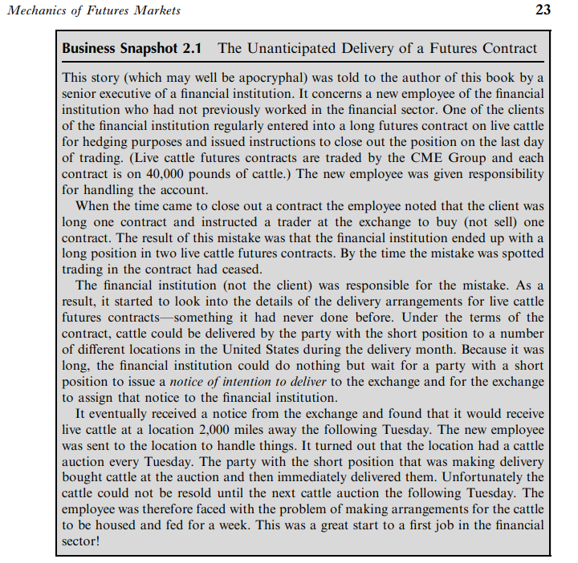
Homework
Summarize Business Snapshot 2.1 in page 25

Slide 9
Market quotes
Prices
Settlement price
Trading Volume and Open Interest: The trading volume is the number of contracts traded in a day. It can be contrasted with the open interest, which is the number of contracts outstanding, that is, the number of long positions or, equivalently, the number of short positions.
Patterns of Futures

Slide 10
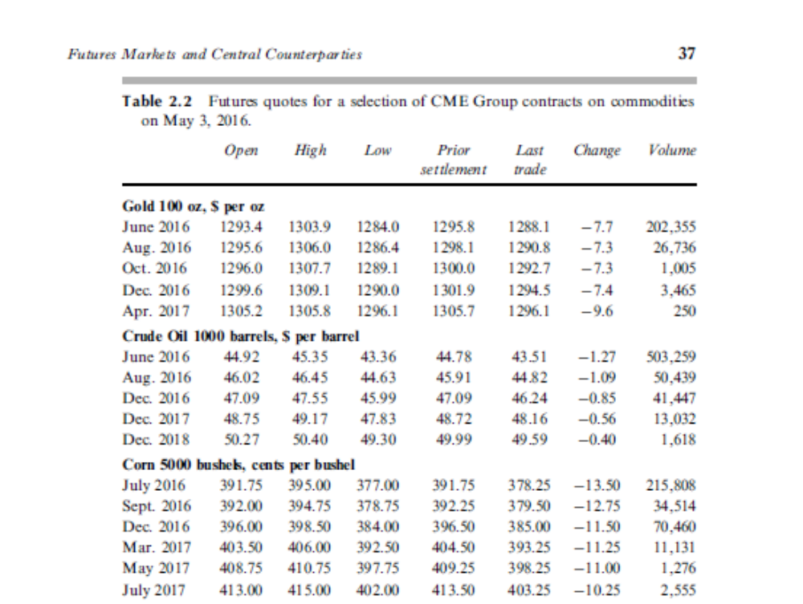

Slide 11
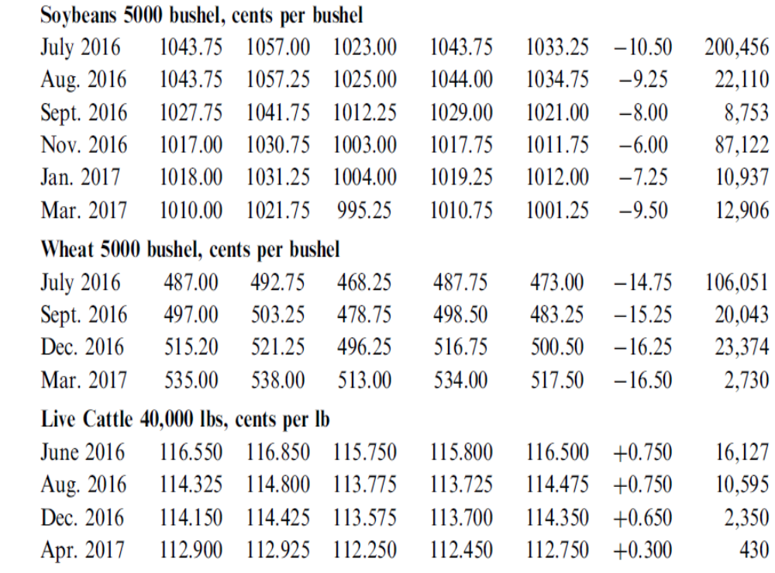


Slide 12
Some Terminology
Open interest: the total number of contracts outstanding. This equals to number of long positions or number of short positions
Settlement price: The settlement price is the price used for calculating daily gains and losses and margin requirements. It is usually calculated as the price at which the contract traded immediately before the end of a day’s trading session.
Volume of trading: the number of trades in 1 day

Slide 13
Questions
When a new trade is completed what are the possible effects on the open interest?
Can the volume of trading in a day be greater than the open interest?

Slide 14
Patterns of futures price
Normal market: The settlement futures prices increase with the maturity of the contract.
Inverted market: the settlement futures prices decrease with the maturity of the contract.

Slide 15
Convergence of Futures to Spot (Figure 2.1, page 25)
Futures
Price
Spot Price
Spot Price
Futures
Price
Time
Time
(a)
(b)

Slide 16
Forward Contracts
A forward contract is an OTC agreement to buy or sell an asset at a certain time in the future for a certain price
There is no daily settlement (but collateral may have to be posted). At the end of the life of the contract one party buys the asset for the agreed price from the other party
Notes:
10

Slide 17
OTC markets
Central Counterparties: are clearing houses for standard OTC transactions that perform much the same role as exchange clearing houses. Members of the CCP, similarly to members of an exchange clearing house, have to provide both initial margin and daily variation margin.
Bilateral Clearing: two companies A and B usually enter into a master agreement covering all their trades. This agreement usually includes an annex, referred to as the credit support annex or CSA, requiring A or B, or both, to provide collateral. The collateral is similar to the margin required by exchange clearing houses or CCPs from their members. Collateral agreements in CSAs usually require transactions to be valued each day.

Slide 18
The Clearing House and Its Members
A clearing house acts as an intermediary in futures transactions. It guarantees the performance of the parties to each transaction. The clearing house has a number of members.
Brokers who are not members themselves must channel their business through a member and post margin with the member.
The main task of the clearing house is to keep track of all the transactions that take place during a day, so that it can calculate the net position of each of its members.
The clearing house member is required to provide to the clearing house initial margin (sometimes referred to as clearing margin) reflecting the total number of contracts that are being cleared. There is no maintenance margin applicable to the clearing house member.

Slide 19
Profit from a Long Forward or Futures Position
Profit
Price of Underlying
at Maturity
Notes:
14

Slide 20
Profit from a Short Forward or Futures Position
Profit
Price of Underlying
at Maturity
Notes:
15

Slide 21
Forward Contracts vs Futures Contracts (Table 2.3, page 40)
Forward | Futures
Private contract between two parties | Traded on an exchange
Not standardized | Standardized
Usually one specified delivery date | Range of delivery dates
Settled at end of contract | Settled daily
Delivery or final settlement usual | Usually closed out prior to maturity
Some credit risk | Virtually no credit risk

Slide 22
II. Hedging strategies using futures
Basic principles
  1.1. Short hedge
1.2.Long hedge
1.3. Basis risk
1.4. Choice of contract
2. Cross hedging
3. Stock index futures
  3.1. Hedging an equity portfolio
  3.2. Changing the beta of a portfolio

Slide 23
Long & Short Hedges
A long futures hedge is appropriate when you know you will purchase an asset in the future and want to lock in the price
A short futures hedge is appropriate when you know you will sell an asset in the future & want to lock in the price

Slide 24
Short Hedges- Example (a)
It is May 15 today and an oil producer has just negotiated a contract to sell 1 million barrels of crude oil. It has been agreed that the price that will apply in the contract is the market price on August 15. How does the firm hedge its exposure?
Suppose that on May 15, the spot price is $60 per barrel and the crude oil futures price on the NYMEX for August delivery is $59 per barrel. Each futures contract on NYMEX is for the delivery of 1,000 barrels.
Short hedge: the company can hedge its exposure by shorting 1,000 futures contracts for August delivery and close its position on August 15.

Slide 25
Short Hedges- Example (b)
On August 15
(1) Suppose the spot price is $55 per barrel:
→ The firm realizes $55 million for the oil under its sales contract.
August is the delivery month for the futures contract → The futures price on August 15 should be very close to the spot price of $55 on that date. → The firm gains approximately 59 - 55= $4 per barrel or $4 million in total from the short futures position.
Total amount realized from both the futures position and the sales contract is approximately $59 per barrel or $59 million in total.

Slide 26
Short Hedges- Example (c)
On August 15
(2) Suppose the spot price is $65 per barrel:
→ The firm realizes $65 million for the oil under its sales contract.
August is the delivery month for the futures contract → The futures price on August 15 should be very close to the spot price of $65 on that date. → The firm losses approximately 65 - 59= $6 per barrel or $6 million in total from the short futures position.
Total amount realized from both the futures position and the sales contract is approximately $59 per barrel or $59 million in total.

Slide 27
Long Hedges- Example (a)
It is now January 15. A copper fabricator knows it will require 100,000 pounds of copper on May 15 to meet a certain contract. How does the firm hedge its exposure?
Suppose that the spot price of copper is 340 cents per pound, and the futures price for May delivery is 320 cents per pound.
Long hedge: the firm can hedge its exposure by taking a long position in four futures contract on COMEX division of NYMEX and closing its position on May 15.

Slide 28
Long Hedges- Example (b)
On May 15:
(1) Suppose the spot price is 325 cents per pound.
→ The firm pays: 100,000 x$3.25= $325,000 for the copper in the spot market.
May is the delivery month for the futures contract → The futures price on May 15 should be very close to the spot price of 325 cents on that date. → The firm gains approximately 325 - 320= 5 cents per pound or $5000 on the futures contract.
It net cost is approximately $320,000 or 320 cents per pound.

Slide 29
Long Hedges- Example (c)
On May 15:
(1) Suppose the spot price is 305 cents per pound.
→ The firm pays: 100,000 x$3.05= $305,000 for the copper in the spot market.
May is the delivery month for the futures contract → The futures price on May 15 should be very close to the spot price of 305 cents on that date. → The firm losses approximately 320- 305= 15 cents per pound or $15000 on the futures contract.
It net cost is approximately $320,000 or 320 cents per pound.

Slide 30
Homework
Read 3.2 ARGUMENTS FOR AND AGAINST HEDGING (page 51) in the textbook to discuss whether a firm should hedge the risks or should not hedge and focus on their main activities.

Slide 31
Basis risk:
In practice, hedging is often not quite as straightforward, because:
→The asset whose price is to be hedged may not exactly the same as the asset underlying the futures contract.
The hedger may be uncertain as to the exact date when the asset will be bought or sold.
The hedge may require the futures contract to be closed out before its delivery month.
Basis risk often exists.

Slide 32
Convergence of Futures to Spot
(Hedge initiated at time t₁ and closed out at time t₂)
Futures
Price
Spot
Price
Time
t₁
t₂

Slide 33
Basis Risk
Basis is the difference between spot & futures:
Basis= Spot price of asset to be hedged – Futures price of contract used
Basis risk arises because of the uncertainty about the basis when the hedge is closed out

Slide 34
Long Hedge
Suppose that
    F₁ : Initial Futures Price (time t1)
    F₂ : Final Futures Price (time t2)
    S₂ : Final Spot Price (time t2)
    Basis=b2 = S2-F2
You hedge the future purchase of an asset by entering into a long futures contract
Cost of Asset=S₂ – (F₂ – F₁) = F₁ + Basis
If basis increases unexpectedly , the hedger’s position worsen; if basis decreases unexpectedly, the hedger’s position improves.

Slide 35
Short Hedge
Suppose that
    F₁ : Initial Futures Price (time t1)
    F₂ : Final Futures Price (time t2)
    S₂ : Final Spot Price (time t2)
    Basis= b2= S2-F2
You hedge the future sale of an asset by entering into a short futures contract
Price Realized=S₂+ (F₁ – F₂) = F₁ + Basis
If basis increases, the hedger’s position improves unexpectedly; if basis decreases unexpectedly, the hedger’s position worsens.

Slide 36
If the asset underlying the futures contract is not the same as the asset whose price is being hedged:
S2* : spot price of the underlying asset at time t2 :
F1-F2 +S2 = F1 + (S2*-F2)+(S2-S2*)
Basis consists of two components:
S2*-F2 : the difference between spot & futures of the underlying asset.
S2-S2* : the difference between the spot prices of the two assets.

Slide 37
Problems
1.On March 1 the spot price of a commodity is $20 and the July futures price is $19. On June 1 the spot price is $24 and the July futures price is $23.50. A company entered into a futures contracts on March 1 to hedge the purchase of the commodity on June 1. It closed out its position on June 1. What is the effective price paid by the company for the commodity?
2. On March 1 the price of a commodity is $300 and the December futures price is $315. On November 1 the price is $280 and the December futures price is $281. A producer entered into a December futures contracts on March 1 to hedge the sale of the commodity on November 1. It closed out its position on November 1. What is the effective price received by the producer?

Slide 38
Choice of Contract (a)
The choice of the asset underlying the futures contract.
The choice of the delivery month

Slide 39
Choice of Contract (b)
Choose a delivery month that is as close as possible to, but later than, the end of the life of the hedge
When there is no futures contract on the asset being hedged, choose the contract whose futures price is most highly correlated with the asset price.

Slide 40
Choice of Contract- Example (a)
It is March 1. A US company expects to receive 50 million Japanese yen at the end of July. Yen futures contracts on the CME have delivery months of March, June, September and December. One contract is for the delivery of 12.5 million yen.
The company shorts four September yen futures contract on March 1. When the yen are received at the end of July, the company closes out its position.
The futures price on March 1 in cents per yen is 0.7800 and the spot and futures prices when the contract is closed out are 0.72000 and 0.7250, respectively.

Slide 41
Choice of Contract- Example (b)
The gain on the futures contract: 0.7800-0.7250 = 0.0550 cents per yen.
The basis: 0.72000-0.7250= -0.0050.
The effective price obtained in cents per year:
The final spot price + the gain
0.7200 + 0.0550 = 0.7750
Or the initial future price + the final basis
0.7800 + (-0.0050) = 0.7750

Slide 42
Cross hedging:
When the asset underlying the futures contract is not the same as the asset to be hedged.
Ex: An airline is concerned about the future price of jet fuel. Because there is no futures contract on jet fuel, it might choose to use heating oil futures contracts to hedge its exposure.

Slide 43
Hedge ratio: is the ratio of the size of the position taken in futures contracts to the size of the exposure.
When the asset underlying the futures contract is the same as the asset being hedged, the hedge ratio equals 1.
The hedger should choose a value for the hedge ratio that minimizes the variance of the value of the hedged position.

Slide 44
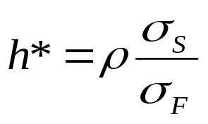
Optimal Hedge Ratio
Proportion of the exposure that should optimally be hedged is
where
σ_{S} is the standard deviation of ΔS, the change in the spot price during the hedging period,
σ_{F} is the standard deviation of ΔF, the change in the futures price during the hedging period
ρ is the coefficient of correlation between ΔS and ΔF.

Slide 45
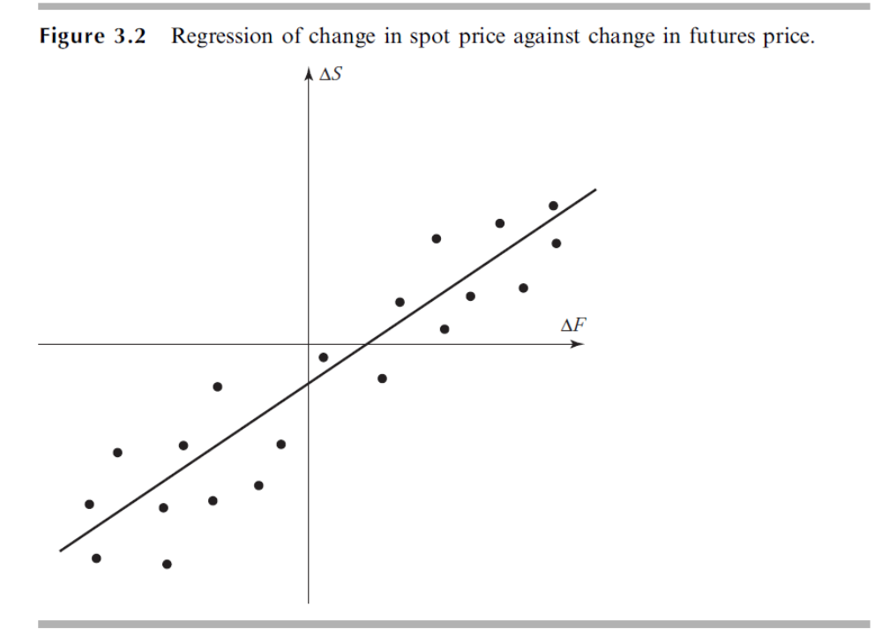
Optimal Hedge Ratio

Slide 46
How to calculate h*?
- Using data on the changes in historical spot and futures prices.
+ Choose a number of equal non-overlapping time intervals. Ideally, the length of each interval is the same as the length of the time interval for which the hedge is in effect.
+ Observe the changes in spot price of the asset being hedged and the changes in future price of the underlying asset. → Compute the standard deviations of these changes.

Slide 47
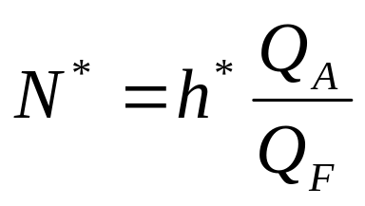
Optimal number of contracts
QA: Size of position being hedged (units)
QF: Size of one futures contract (units)
- N* : Optimal number of futures contracts for hedging.

Slide 48
Ex: An airline expects to purchase 2 million gallons of jet fuel in 1 month and decides to use heating oil futures for hedging. The size of one heating oil futures contract is 42,000 gallons → Compute the optimal number of futures contracts for hedging.

Slide 49
Data on the changes in historical prices:
Month (i) | Changes in heating oil futures price per gallon (xi) | Changes in jet fuel price per gallon (yi)
1 2 3 4 5 6 7 8 9 10 11 12 12 14 15 | 0.021 0.035 -0.046 0.001 0.044 -0.029 -0.026 -0.029 0.048 -0.006 -0.036 -0.011 0.019 -0.027 0.029 | 0.029 0.020 -0.044 0.008 0.026 -0.019 -0.010 -0.007 0.043 0.011 -0.036 -0.018 0.009 -0.032 0.023

Slide 50
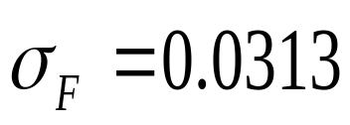
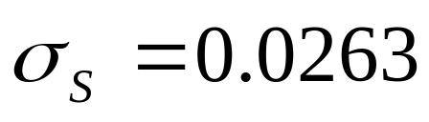
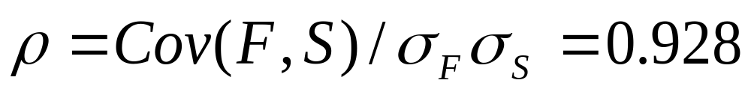
Method 1: Calculate mean, standard deviation, correlation of the changes in the spot and futures prices.
h= 0.928x(0.0263/0.0313) = 0.78
Method 2: h* is the slope of the best-fit line when deltaS is regressed against deltaF.
deltaS = 0.78 deltaF

Slide 51
The optimal number of futures contracts for hedging:
0.78 x 2,000,000/42,000 = 37.14

Slide 52
Problems
3. Suppose that the standard deviation of quarterly changes in the prices of a commodity $0.65, the standard deviation of quarterly changes in a futures price on the commodity is $0.81, and the coefficient of correlation between the two changes is 0.8. What is the optimal hedge ratio for a 3-month contract? What does it mean?
4. The standard deviation of monthly changes in the spot price of live cattle is (in cents per pound) 1.2. The standard deviation of monthly changes in the futures price of live cattle for the closest contract is 1.4. The correlation between the futures price changes and the spot price changes is 0.7. A beef producer is committed to purchasing 200,000 pounds of live cattle next month. The producer wants to use the live cattle futures contracts to hedge its risk. Each contract of/ for the delivery of 40,000 pounds of cattle. What strategy should the beef producer follow?

Slide 53
  Stock index futures
A stock index tracks changes in the value of a hypothetical portfolio of stocks.
The weight assigned to the stocks are proportional to their market prices or their market capitalizations.
Return on the stock index is usually used as a proxy of the market return. The stock index is given a beta of 1.
Some exchanges provide futures contracts for underlying assets of stock indices. For example: Dow Jones Industrial Average, S&P500, Nasdaq 100 Index futures contracts.

Slide 54
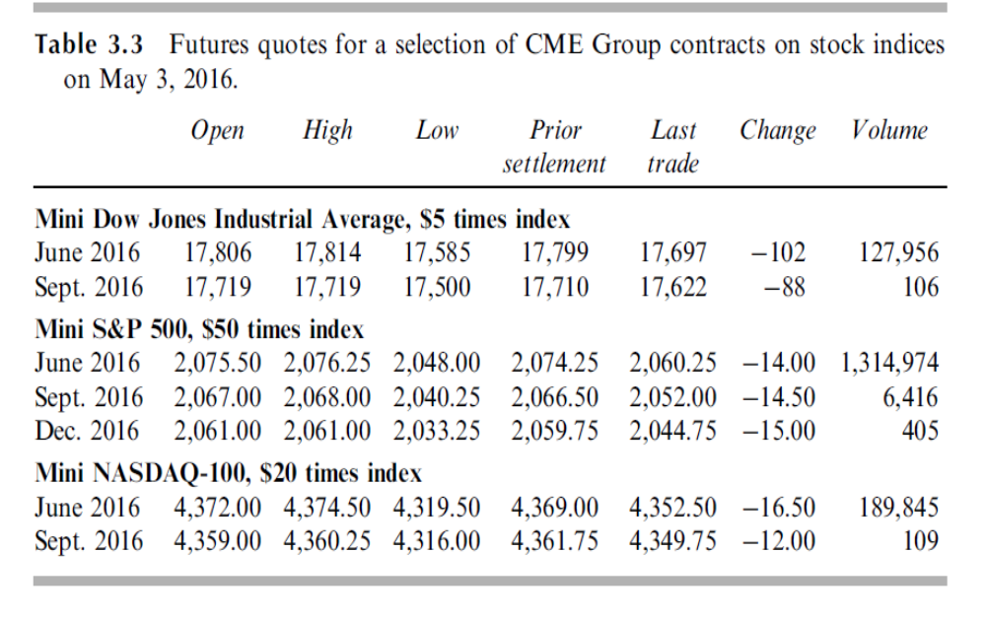

Slide 55
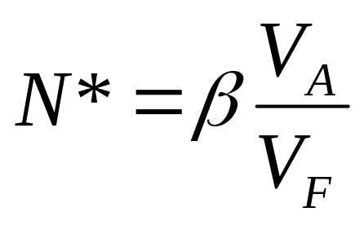
Hedging Using Index Futures
To hedge the risk in a portfolio the number of contracts that should be shorted is
where V_{A} is the current value of the portfolio, β is its beta, and V_{F} is the current value of one futures (=futures price times contract size)

Slide 56
Example (a) : Suppose that a futures contract with 4 months to maturity is used to hedge the value of a portfolio over the next 3 months:
Value of portfolio= $5,050,000
Beta of portfolio= 1.5
Value of S&P 500 index= 1000
S&P 500 futures price= 1,010 USD
Risk-free interest rate =4% per annum
Dividend yield on index =1% per annum
One contract is on $250 times the index
- What position in futures contracts on the S&P 500 is necessary to hedge the portfolio?

Slide 57
Example (c)
Suppose that the index turns out to be 900 in 3 months and the futures price is 902. Calculate the value of the hedged portfolio in 3 months?

Slide 58
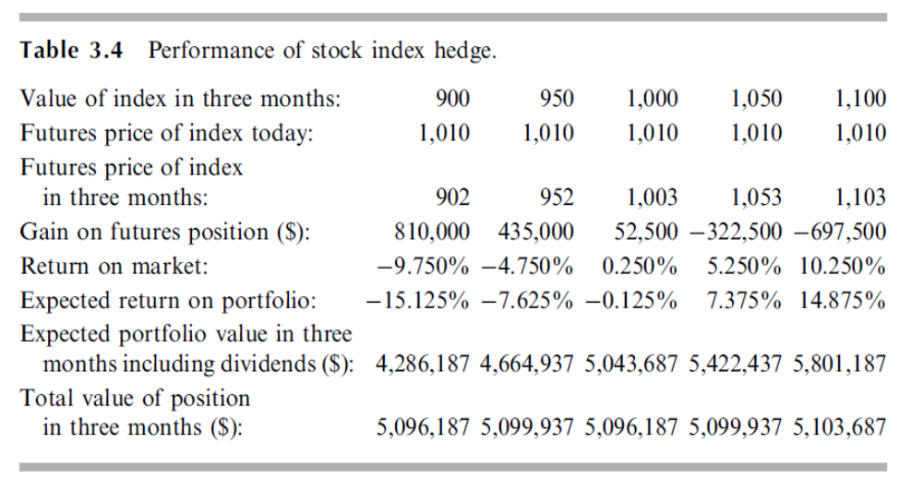

Slide 59
Problems
5. On July 1, an investor holds 50,000 shares of a certain stock. The market price is $30 per share. The investor is interested in hedging against movements in the market over the next month and decides to use the September Mini S&P 500 futures contract. The index futures price is currently 1,500 and one contract is for delivery of $50 times the index. The beta of the stock is 1.3. What strategy should the investor follow?

Slide 60
6. A fund manager has a portfolio worth $50 million with a beta of 0.87. The manager is concerned about the performance of the market over the next 2 months and plans to use 3-month futures contracts on the S&P 500 to hedge the risk. The current level of the index is 1,250, one contract is on 250 times the index, the risk-free rate is 6% per annum, and the dividend yield on the index is 3% per annum. The current 3-month futures prices is 1259.
What position should the fund manager take to hedge all exposure to the market over the next 2 months?
Suppose that in 2 months, the index decreases to 1000, and the index futures price is 1002.5. Calculate the expected value of the company after hedging the risk.

Slide 61
Homework
Reasons for Hedging an Equity Portfolio
The hedger might be very uncertain about the performance of the market as a whole, but confident that the stocks in the portfolio will outperform the market (after appropriate adjustments have been made for the beta of the portfolio). A hedge using index futures removes the risk arising from market moves and leaves the hedger exposed only to the performance of the portfolio relative to the market.
Another reason for hedging may be that the hedger is planning to hold a portfolio for a long period of time and requires short-term protection in an uncertain market situation. The alternative strategy of selling the portfolio and buying it back later might involve unacceptably high transaction costs.
Read p.66

Slide 62
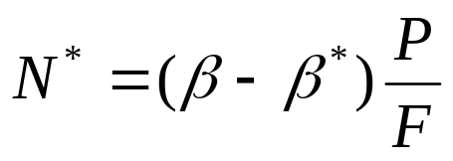

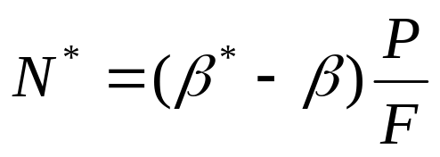
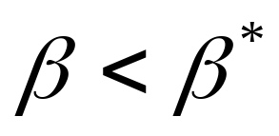
Changing the beta of a portfolio
Sometimes futures contracts are used to change the beta of a portfolio to some value other than zero.
To reduce the beta, the number of futures contract should be shorted:
To increase the beta, the number of futures contracts should be taken in a long position:

Slide 63
Example
Value of portfolio= $5,050,000
Beta of portfolio= 1.5
Value of S&P 500 index= 1000
S&P 500 futures price= 1,010 USD
One contract is on $250 times the index
→ What position is necessary to reduce the beta of the portfolio to 0.75?
→ What position is necessary to increase the beta of the portfolio to 2.0?

Slide 64
Problems
7. A company has a $20 million portfolio with a beta of 1.2. It would like to use futures contracts on the S&P 500 to hedge its risk. The index futures price is currently standing at 1080, and each contract is for delivery of $250 times the index. What is the hedge that minimizes risk? What should the company do if it wants to reduce the beta of the portfolio to 0.6?

Slide 65
Problems
8. It is July 16. A company has a portfolio of stocks worth $100 million. The beta of the portfolio is 1.2. The company would like to use the CME December futures contract on the S&P 500 to change the beta of the portfolio to 0.5, during the period July 16 to November 16. The index futures price is currently 1,000, and each contract is on $250 times the index.
What position should the company take?
Suppose that the company changes its mind and decides to increase the beta of the portfolio from 1.2 to 1.5. What position in futures contracts should it take?

